Slide 1
Structures & Unions
Notes:
1

Slide 2
Structures
We’ve seen variables of simple data types, such as float, char, and int.
Variables of such types represent one item of information: a height, an amount, a count, and so on.
But just as groceries are organized into bags, employees into departments, and words into sentences, it’s often convenient to organize simple variables into more complex entities.
The C++ construction called the structure is one way to do this.
2
Notes:
2

Slide 3
Structures
A structure is a collection of one or more variables, possibly of different types, grouped together under a single name for convenient handling .
The variables in a structure can be int, some can be float, and so on. This is unlike the array, in which all the variables must be the same type. The data items in a structure are called the members of the structure.
3
Notes:
3

Slide 4
Structures assist program organisation by
  Grouping logically related data, and giving this set of variables a higher-level name and more abstract representation.
  Enabling related variables to be manipulated as a single unit rather than as separate entities.
  Reducing the number of parameters that need to be passed between functions.
  Providing another means to return multiple values from a function.
4
Notes:
4

Slide 5
The general format of a structure definition is
struct tag_name
{
Data_type member1;
Data_type member2;
----------------
};
Example:-1
struct student
{ int rollno;
    int age;
    char name[10];
    float height;
    };
5
Notes:
5

Slide 6
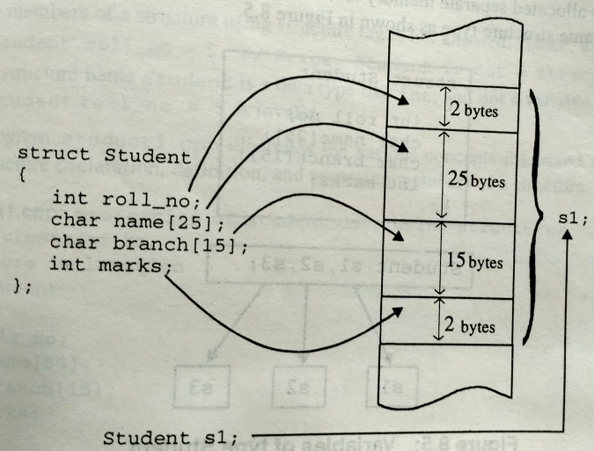

Slide 7
Rules for defining structure
The structure template is terminated with a semicolon.
While the entire declaration is considered as a statement, each member is declared independently for its name and type in a separate statement inside the template.
The tag name such as student can be used to declare structure variables of its type, later in the program.
7
Notes:
7

Slide 8
Declaring Structure Variables
Example-2
Declare them at the structure definition.
struct student
{ int rollno;
    int age;
    char name[10];
    float height;
    }s1, s2, s3;
2. Define the variables at some point after the structure definition.
    student s1, s2, s3;
8
Notes:
8

Slide 9
Note:
Members of a structure themselves are not variables.
They (members) do not occupy any memory until they are associated with the structure variables such as s1, s2, s3 etc.
Normally, structure definitions appear at the beginning of the program file, before any variables or functions are defined.
They may also appear before main. In such cases, the definition is global and can be used by other functions as well.
9
Notes:
9

Slide 10
The sizeof operator is used to find the size of structure.
sizeof(struct x)→ gives the number of bytes required to hold all the members of the structure x.
If y is a simple structure variable of type struct x, then the expression sizeof(y) →would also give the same answer.
10
Notes:
10

Slide 11
Giving values to members.
The link between member and a structure variable is established using the member operator ‘.’ which is also known as ‘dot operator’ .
For example,
s1. rollno is the variable representing the rollno of student s1 and can be treated like any other ordinary variable.
11
Notes:
11

Slide 12
Here is how we would assign values to the members of student s1
strcpy(s1.name, “Anil”);
s1.rollno=1335;
s1.age=18;
s1.height=5.8;
We can also use cin to give the values through the keyboard.
cin>>s1.name>>s1.age>>s1.rollno>>s1.height;
12
Notes:
12

Slide 13
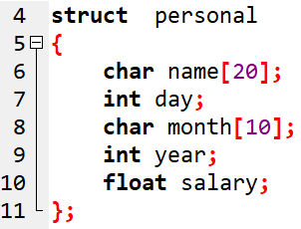
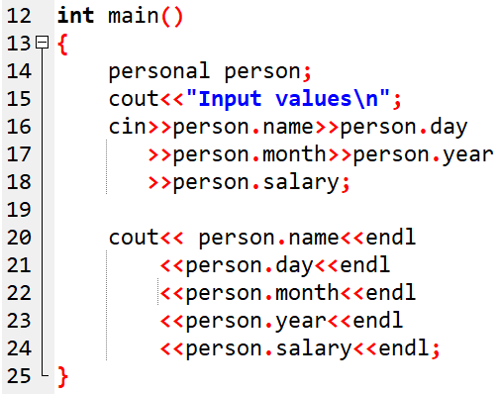
Example-3
13
Notes:
13

Slide 14
Structure initialization
Example-4
struct part
{ int modelnumber;
int partnumber;
float cost;
};
int main()
{
part part1 = { 6244, 373, 217.55 };
}
14
Notes:
14

Slide 15
The values to be assigned to the structure members are surrounded by braces and separated by commas.
The first value in the list is assigned to the first member, the second to the second member and so on.
The order of values in the initializer list matches the order of declarations in the structure.
15
Notes:
15

Slide 16
Comparison of structure variables
If person1 and person2 belong to the same structure, then the following operation is valid.
person1 = person2; // Assign person2 to person1
But if(person1==person2 ) // illegal
if(person1!=person2) //illegal
16
Notes:
16

Slide 17
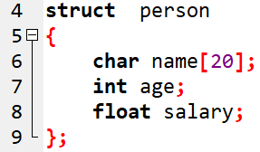
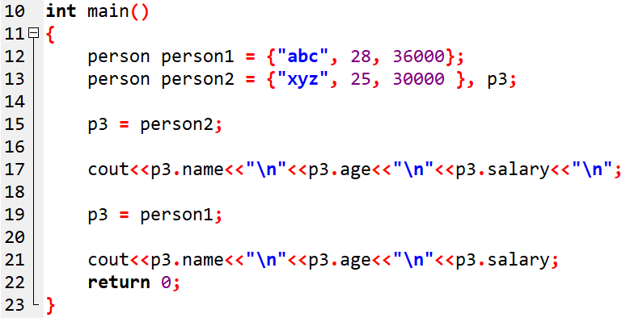
Example-5

Slide 18
Arrays of structures
For example,
class1 student[100]; → defines an array called student, that
consists of 100 elements.
18
Notes:
18

Slide 19
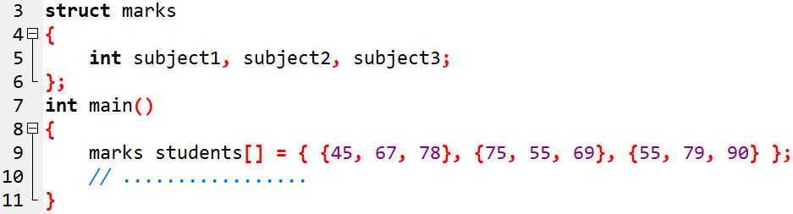
Example-6
This declares the student as an array of 3 elements and initializes their members as follows.
student[0].subject1=45;
student[0].subject2=67;
student[0].subject3=78;
………………………….
……………………….
student[2].subject3=90;
19
Notes:
19

Slide 20
Arrays within structures
We can use single or multidimensional arrays inside a structure.
struct marks
{
int number;
float sub[3];
} student[2];
The member sub contains 3 elements sub[0], sub[1],sub[2]. These elements can be accessed using appropriate subscripts.
20
Notes:
20

Slide 21
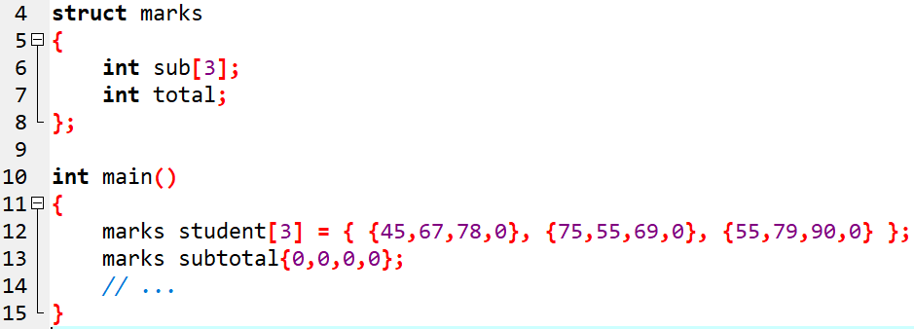
student[1].sub[2]→ refers to the mark in third subject by the second student.
21
Notes:
21

Slide 22
STRUCTURES WITHIN STRUCTURES
Structure within structure means nesting of structures.
Consider the following structure defined to store information about the salary of employees
struct salary
{
char name[20];
char dept[10];
int basic_pay;
int dearness_allowance;
int h_allowance;
int city_allowance;
}employee;
22
Notes:
22

Slide 23
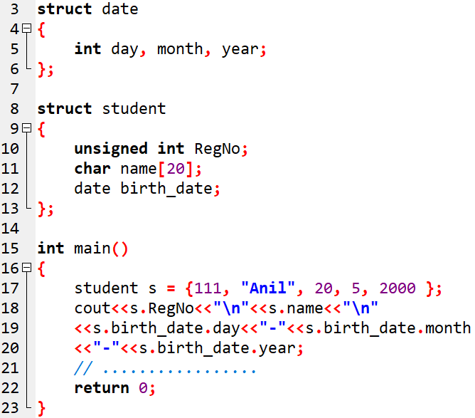
STRUCTURES WITHIN STRUCTURES

Slide 24
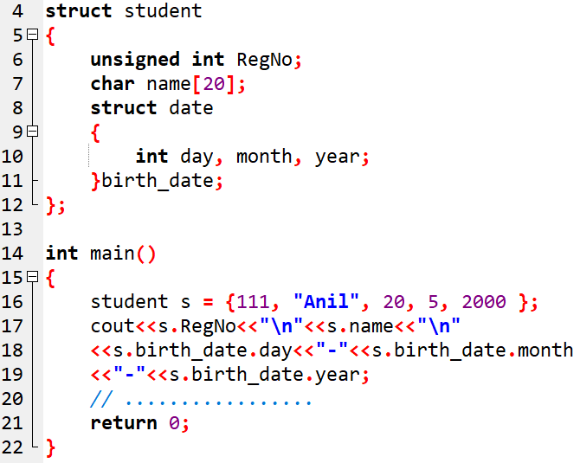

Slide 25
It is also permissible to nest more than one type of structures.
struct personal_record
{
struct name_part name;
struct addr_part address;
struct date date_of_birth;
……
….
};
struct personal_record person1;
25
Notes:
25

Slide 26
Unions
Unions look similar to structures.
They have identical declaration syntax and member access.
The major difference between them in terms of storage.
In structures, each member has its own storage location.
Whereas all the members of a union use the same location.
This implies that, although a union may contain many numbers of different types. It can handle only one member at a time.
26
Notes:
26

Slide 27
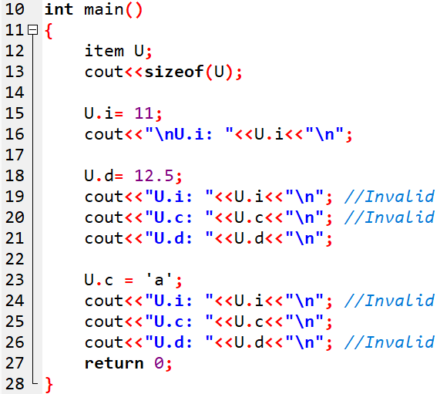
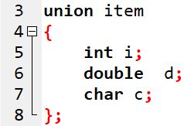
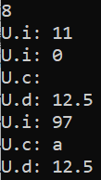

Slide 28
A union holds the value of one-variable at a time.
The compiler allocates a piece of storage that is large enough to hold the biggest member of the union.
In the declaration above, the member d requires 8 bytes which is the largest among the members
28
Notes:
28

Slide 29
User defined Type declarations
typedef
  Type definition - lets you define your own identifiers.
enum
  Enumerated data type - a type with restricted set of values.

Slide 30
User defined Type Declaration
typedef : general declaration format
typedef type identifier;
The “type” refers to an existing data type and “identifier” refers to the new name given to the data type.
After the declaration as follows:
typedef int marks;
typedef float units;
we can use these to declare variables as shown
marks m1,m2[10]; //m1 & m2[10] are declared as integer variables
units u1, u2; //u1 & u2 are declared as floating point variables
The main advantage of typedef is that we can create meaningful data type names for increasing the readability of the program.

Slide 31
User defined Type Declaration
enum data type : general declaration format
enum identifier {value1, value2,..,value_{n}};
The “identifier” is a user defined enumerated data type which can be used to declare variables that can have one of the values known as enumeration constants.
After this declaration as follows:
enum identifier v1,v2,…v_{n};
enumerated variables v1,v2,..,v_{n} can only have one of the values value1, value2,…,value_{n}
Notes:
User-defined type –it provides a way for attaching names to numbers. Enum keyword enumerates a list of words by assigning them values 0,1,2….i
Identifier becomes new type names.

Slide 32
User defined Type Declaration
E.g.:
enum day {Monday, Tuesday,… ,Sunday} ;
enum day week_st, week_end;
week_st = Monday; week_end= Friday;
if(week_st == Tuesday)
week_end = Saturday;
Compiler automatically assigns integer starting with 0 to all enumeration constants. But can be overridden.
E.g.:
enum day { Monday=1, Tuesday,…, Sunday};
Monday is assigned 1 & subsequent constants incremented by one.

Slide 33
enum – example
If declared; enum day { Monday=1, Tuesday,…, Sunday};
cout<<"\n\nEnter n >1 &<7., 0 for Exit:- ";
cin>>i;
switch(i)
{
case Monday:
cout<<“Monday.";
break;
case Tuesday
cout<<“ Tuesday.";
break;
case Wednesday:
cout<<“ Wednesday.";
break;
case Thursday:
cout<<“ Thursday.";
break;
case Friday:
cout<<“ Friday.";
break;
case Saturday:
cout<<“\Saturday.";
break;
case Sunday:
cout<<“Sunday.";
break;
case 0:
exit(0);
default:
cout<<"\nInvalid Entry. Enter 0-7.";
break;
}

